Slide 1
IRONHACK PROJECT 1
IBM

Slide 2
Charts & Comment of the result
Plan
Python code

Slide 3
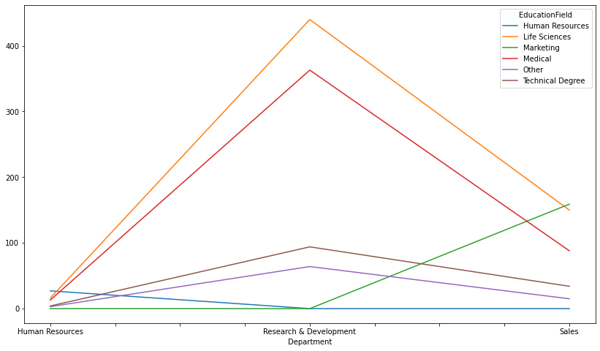

Slide 4
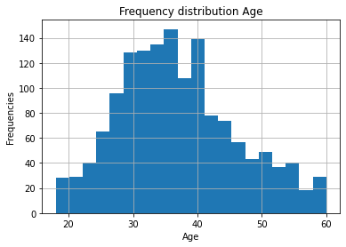
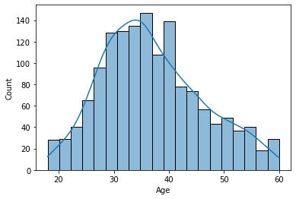
1-Analyse Data: Age

Slide 5
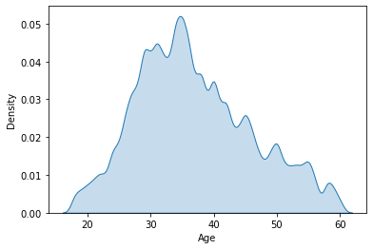
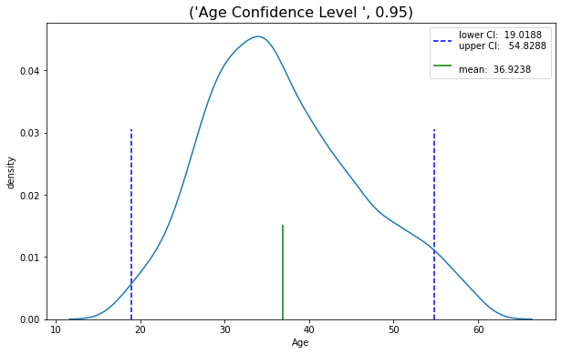
1-Analyse Data: Age

Slide 6
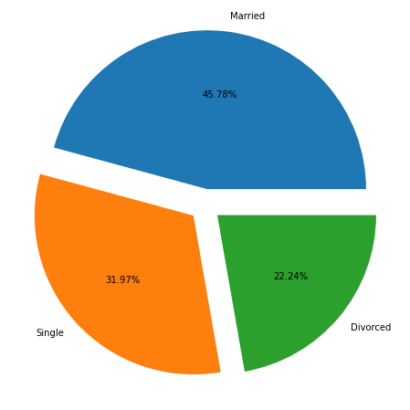
1-Analyse Data: Marital Status

Slide 7
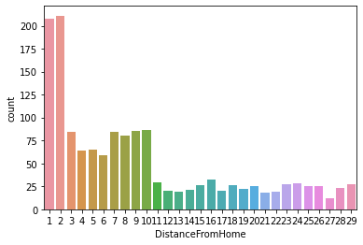
1-Analyse Data: Distance From Home

Slide 8
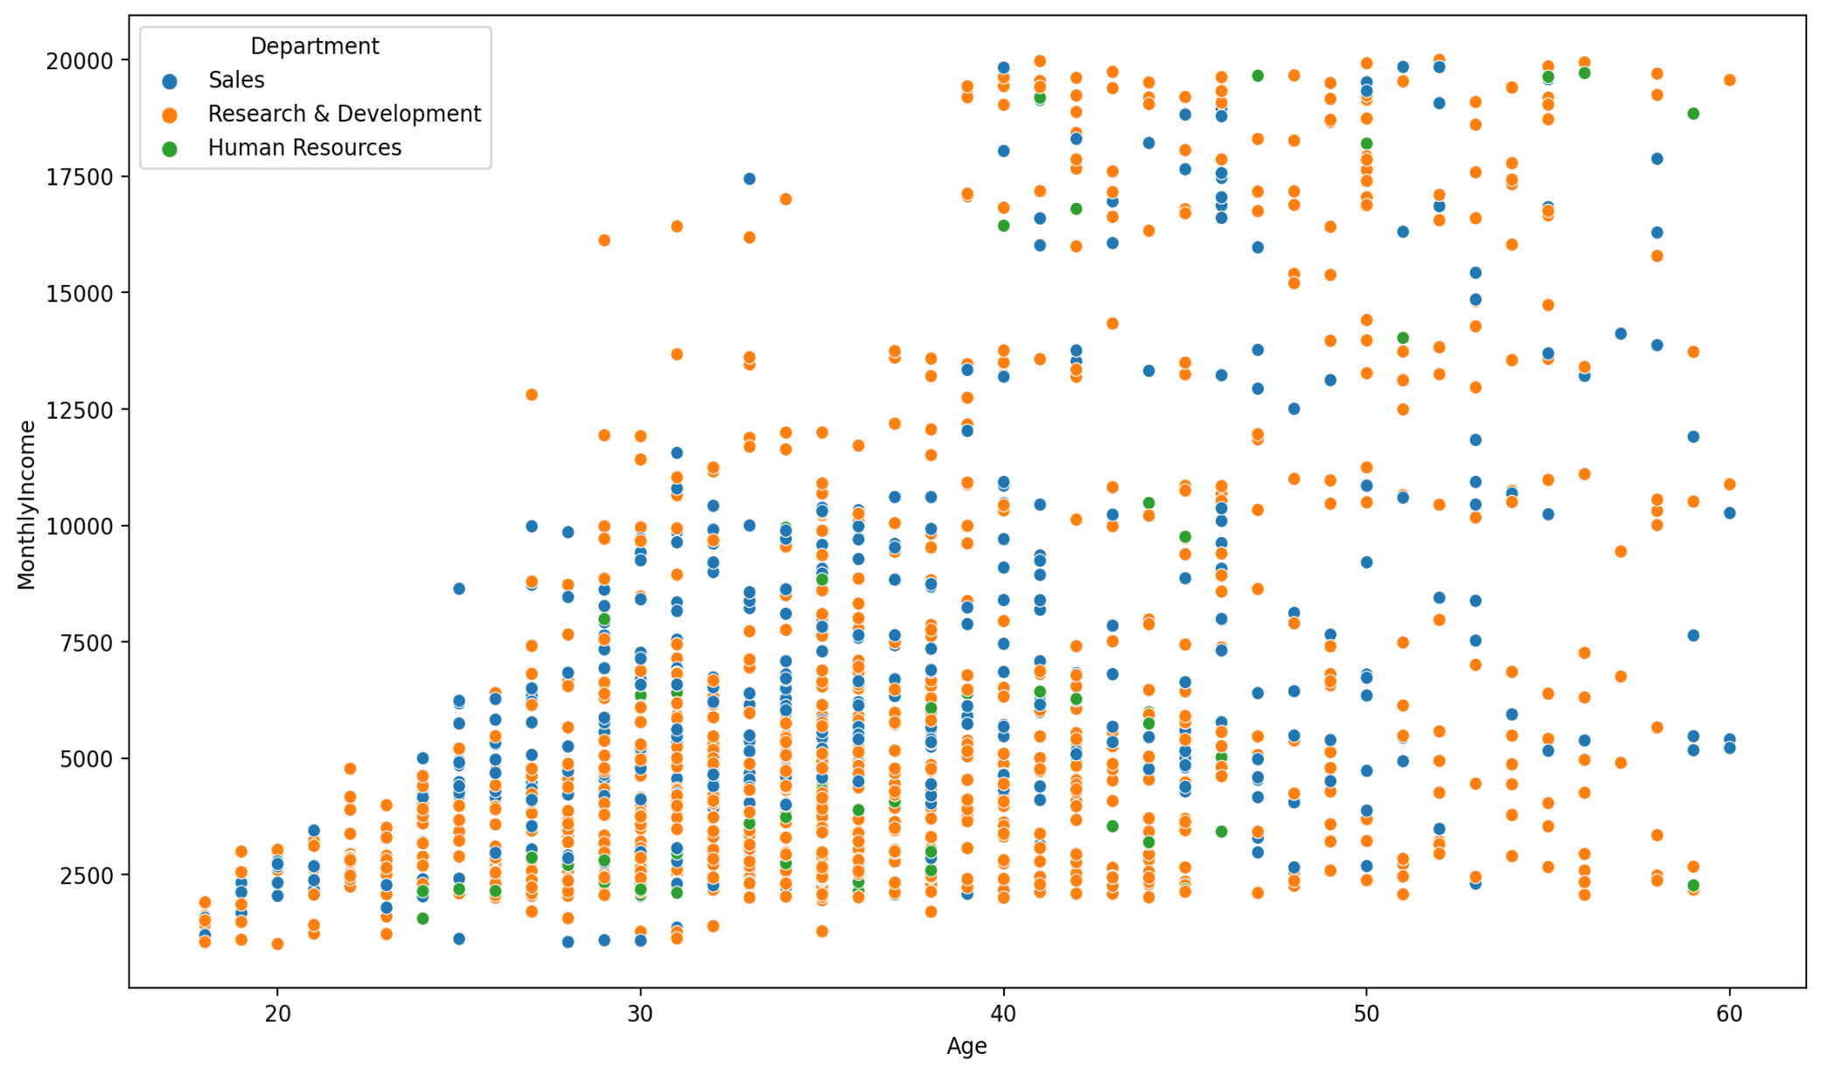
1-Analyse Data: Monthly Income

Slide 9
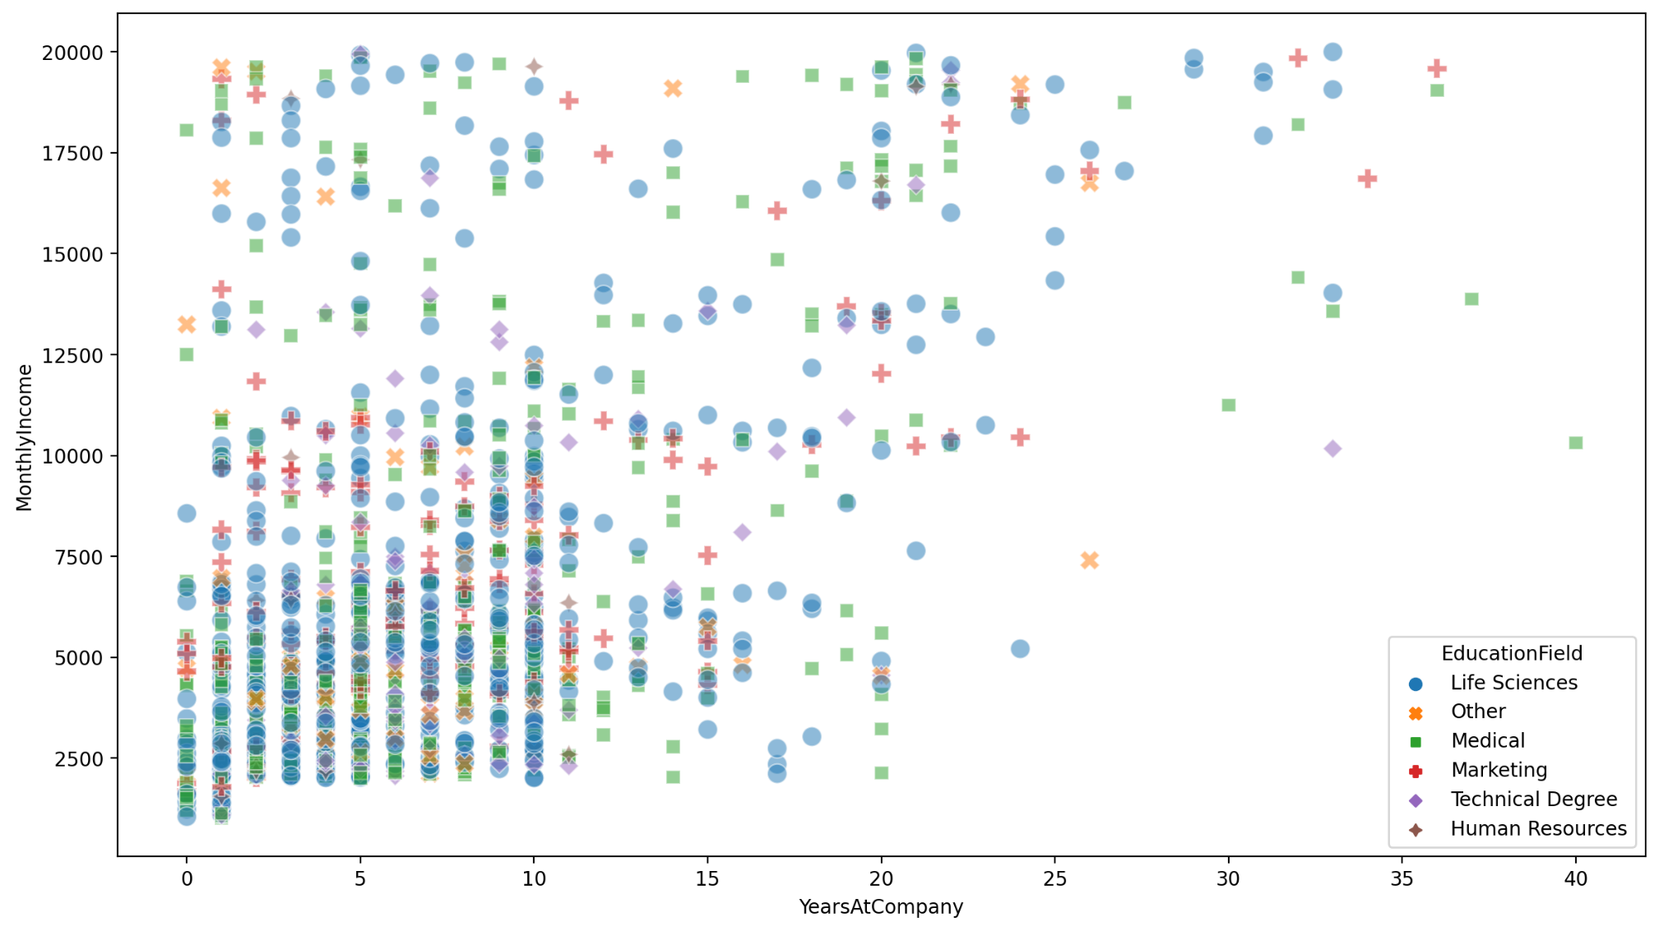
1-Analyse Data: Monthly Income

Slide 10
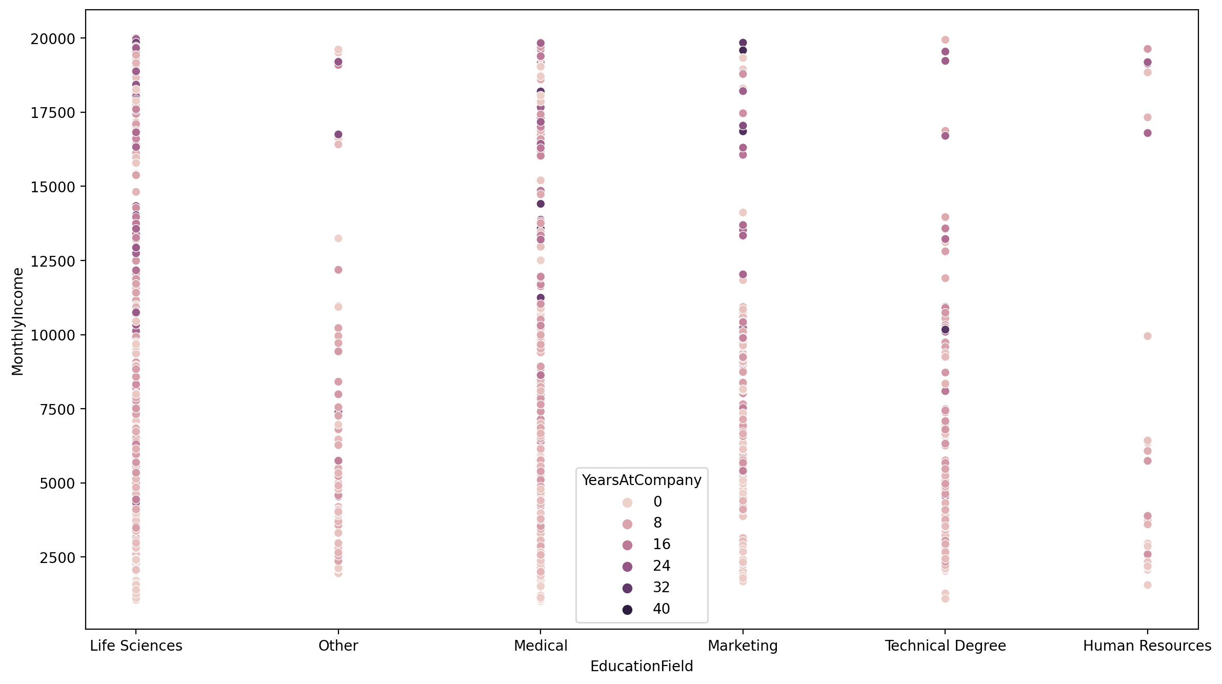
1-Analyse Data: Monthly Income

Slide 11
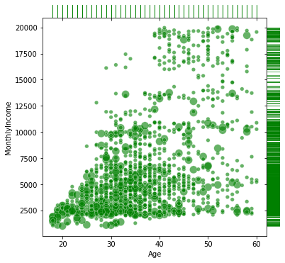
1-Analyse Data: Monthly Income

Slide 12
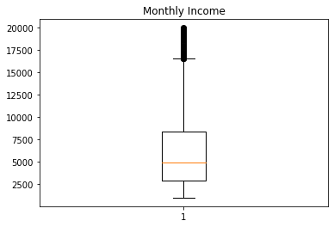
1-Analyse Data: Monthly Income

Slide 13
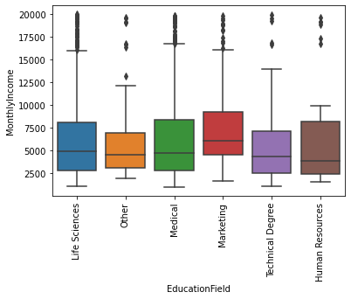
1-Analyse Data: Monthly Income

Slide 14
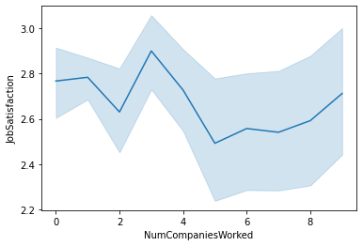

Slide 15
